Slide 1
Winter 25-26
PS -Robotic Sensing and Knowledge Transfer Learning in Safety-Critical Environments
Organization & Introduction
Prof. Dr. Holger Giese (Holger.Giese@hpi.de)
Christian Medeiros Adriano (Christian.Adriano@hpi.de) - “Chris”
Dr. Sona Ghahremani (Sona.Ghahremani@hpi.de)
Finn Kaiser (Finn.Kaiser@hpi.de)
He Xu (He.Xu@hpi.de)
Mustafa Ghani (Mustafa.Ghani@hpi.de)

Slide 2
Key Facts
Weekly Hours: 4
Credit Points: 6
Teaching Form: Project Seminar
Course Language: English
Moodle Website: https://moodle.hpi.de/course/view.php?id=1014

Slide 3
Dates
Milestones
Introductory meeting: 14.10.2025 [NOW]
Enrollment deadline: 31.10.2025
Deregistration deadline: 2 days before the exam, but we ask you to inform us as soon as possible.
Final Presentations: 11.02.2026
Meetings:
      Introductory lectures (3 to 4)
      Project scope discussion and updates – once a week

Slide 4
Communicantion Plan
Motive | Content | Medium
Deliverables | Source code, Data Documentation, Wiki | Github - https://github.com/orgs/hpi-sam/
Slides | Moodle | https://moodle.hpi.de/course/view.php?id=1014
Papers | Copyrighted material | Zotero
Offline discussions | Questions, Suggestions, Sharing | Our Slack group (channel #robotic-sensing-knowledge-transfer) https://sam-reinforce-sas.slack.com
Official communications | Schedule, Orientations, Administrative issues | Email christian.adriano@hpi.de
Meetings | Lectures, Status, Work meetings | Teams Meetings

Slide 5
Project Proposal
Team size preferred: from 2 to 4.
Project proposal in two stages (we will guide you in that)
1- State-of-art (one page, double column) – ~ in approx. 3 weeks
covering at least 10 well-selected papers per person
2- Proposal - first draft ~ in approx. 6 weeks
State the problem (what is it? why should I care?, why is it challenging?)
Describe the scenario (source, size, main features, cite any papers that used it)
Determine the methods that you plan to use (preliminary insights, it might change)
Discuss how you will evaluate your results (benchmarks, baselines, null-models)

Slide 6
Lecture Topics
  Foundations
  Model-Free, Model-Based
  Deep RL, Online, Offline, On-Policy, Off-Policy
  Foundation models for path planning and terrain exploration
  Transfer Reinforcement Learning
  Meta-learning vs Transfer learning, Domain adaptation, and Multi-task learning.
  Causal Reinforcement Learning
  Reward Models
  Intrinsic reward strategies (entropy-driven and diversity-driven)
  Reward Shaping, Policy Transfer, Representation Transfer
  Interpretability Methods
  Attention, Salience, Mechanistic Interpretability

Slide 7
Foundation Models for Robotic Navigation and Rovers
ViNT (Visual Navigation Transformer)
  Trained on large, diverse robot navigation datasets.
  Takes visual goals and outputs navigation actions or subgoals.
  Goal-directed exploration or maze traversal
NavFoM (Embodied Navigation Foundation Model)
  Pretrained on 8M samples across wheeled, legged, and aerial robots.
  Handles multiple tasks: vision-language navigation, search, tracking, driving.
  Terrain-adaptive or multi-task rover behavior
SARO (Space-Aware Robot System)
  Combines vision-language reasoning with reinforcement-learned control.
  Enables high-level task decomposition and 3D terrain navigation.
  For rough or uneven terrain exploration.
Notes:
Here’s a list of references in ACM citation format for the five foundation models discussed:

Slide 8
Foundation Models for Robotic Navigation and Rovers
Words to Wheels
  Converts natural-language commands into navigation plans.
  Uses foundation models for terrain semantics and action generation.
  Human-in-the-loop rover control (“Go to that rock”).
Naver Labs Foundation Model for Robot Navigation
  Trained on heterogeneous data for out-of-the-box generalization.
  Uses CroCo — a geometric foundation model for pose and correspondence.
  Perception and mapping capabilities for unknown environments

Slide 9
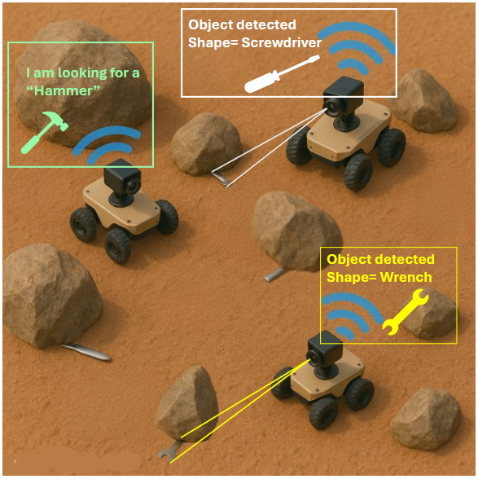
Project Overview

Slide 10
Goal & Challenges
Goal: Robots look for tools while minimizing search time and collisions with obstacles.
Challenges – Elusive Obstacles:
partially block view and access
shift positions (after collisions)
Desiderata:
Knowledge-sharing about obstacles
Representation-sharing about environment topology

Slide 11
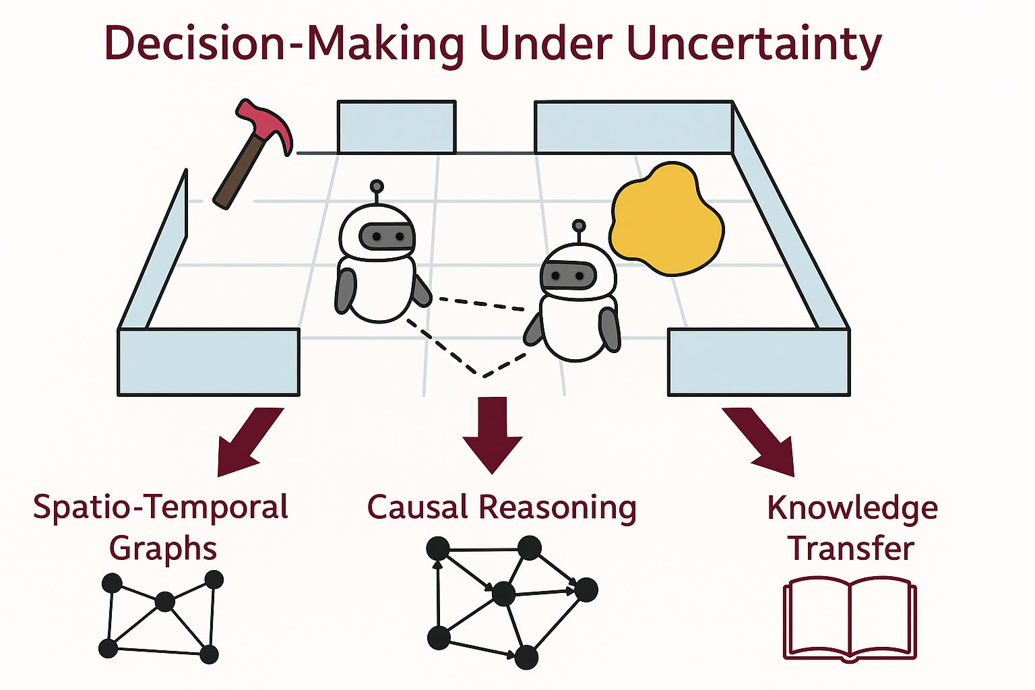
Research Questions & General Approach
Models of Attention and Saliency
Study Representation Models
Evaluate Task Sensitivity to Model Precision
Evaluate Task Robustness to Model Degradation

Slide 12
Scenario
A swarm of robots with individual tasks of finding hardware parts (e.g., hammer, screw driver), while minimizing search time and the number of collisions with obstacles.
Challenges:
Robots must circumvent obstacles that might be blocking access and/or view to the hardware part.
Obstacles can shift their positions (after collisions), hence adding imprecision to the collected data.
Features:
Robots can share knowledge about the relative position of objects.
Robots collaborate to maintain a shared environment representation

Slide 13
Research Goals
RG1- Generate representation models
  Attention (A) to capture the importance of obstacles to tasks.
  Salience (S) to capture the relative prominence among objects in the environment.
RG2- Sensitivity of Attention & Salience Models
Investigate the sensitivity of attention and salience representations to small environmental perturbations. Perturbations would correspond to the subtle shifts to the obstacles (i.e., partially observable).

Slide 14
Research Goals
RG3- Robustness of Robot Tasks
Investigate the sensitivity of obstacle avoidance (safety) and task completion (cost) to small changes in how the robots approach the obstacles. Changes relate to tasks of capturing better (complementary) information about an obstacle that can be shared with other robots (i.e., to infer how an obstacle impedes movement towards the completion of a task).

Slide 15
Approach
Representation Learning: Spatio-temporal graph models for capturing attention and salience as embedded representations of obstacles and tasks. Graph models abstract structural dependencies from observational (sensing) and synthetic data (interventions).
Policy Learning: Reinforcement learning can update policies through interaction with the environment, a representation of it, or by knowledge transfer from other policies.

Slide 16
Technology & Deliverables
  Robots: commercial rovers with cameras and
  Simulators: pretraining robot (e.g., Gazebo, Webots)
  Mini-tutorials: We will provide instructions on how to work with the rover, simulator, as well as on robotic perception, planning, and learning methods.
  Deliverables: source code and a scientific paper

Slide 17
Papers on Reinforcement Learning
Zhu, Z., et al., 2021, Transfer Learning in Deep Reinforcement Learning: A Survey, arXiv preprint arXiv:2009.07888.
Amin, S., et al., 2021, A Survey of Exploration Methods in Reinforcement Learning. arXiv preprint arXiv:2109.00157.
Yu, L., et al., 2021, Robust Reinforcement Learning under model misspecification. arXiv preprint arXiv:2103.15370.
Mendonca, R., et al., 2020, Meta-reinforcement learning robust to distributional shift via model identification and experience relabeling, arXiv preprint arXiv:2006.07178
Kirk, R., et al., 2021, A Survey of Generalisation in Deep Reinforcement Learning, arXiv:2111.09794 [cs]
François-Lavet, V., Henderson, P., Islam, R., Bellemare, M. G., & Pineau, J. (2018). An introduction to deep reinforcement learning. Foundations and Trends® in Machine Learning, 11(3-4), 219-354.

Slide 18
Papers on Meta-Reinforcement Learning
Xu, Z., van Hasselt, H. P., Hessel, M., Oh, J., Singh, S., & Silver, D. (2020). Meta-gradient reinforcement learning with an objective discovered online. Advances in Neural Information Processing Systems, 33, 15254-15264.
Nagabandi, A., Clavera, I., Liu, S., Fearing, R. S., Abbeel, P., Levine, S., & Finn, C. (2018, September). Learning to Adapt in Dynamic, Real-World Environments through Meta-Reinforcement Learning. In International Conference on Learning Representations.
Mitchell, E., Rafailov, R., Peng, X. B., Levine, S., & Finn, C. (2021, July). Offline meta-reinforcement learning with advantage weighting. In International Conference on Machine Learning (pp. 7780-7791). PMLR.
Fakoor, R., Chaudhari, P., Soatto, S., & Smola, A. J. (2019, September). Meta-Q-Learning. In International Conference on Learning Representations.
Hospedales, T., Antoniou, A., Micaelli, P., & Storkey, A. (2021). Meta-learning in neural networks: A survey. IEEE transactions on pattern analysis and machine intelligence, 44(9), 5149-5169.
Sutton, R. S. (1992, July). Adapting bias by gradient descent: An incremental version of delta-bar-delta. In AAAI (pp. 171-176).

Slide 19
Papers on Foundation Models
[1] Yufei Ye, Chen Wang, Dhruv Shah, Jitendra Malik, Sergey Levine. ViNT: A Foundation Model for Visual Navigation. arXiv preprint arXiv:2306.14846, 2023. Available at: https://arxiv.org/abs/2306.14846
[2] Wenxuan Zhou, Zihan Ding, Penghao Wu, Xinyu Huang, Jiankai Sun, et al. NavFoM: Embodied Navigation Foundation Model. arXiv preprint arXiv:2509.12129, 2025. Available at: https://arxiv.org/abs/2509.12129
[3] Yiming Zhao, Hanjun Dai, Zijian Dong, Kaizhi Wang, H. Su. SARO: Space-Aware Robot System. arXiv preprint arXiv:2407.16412, 2024. Available at: https://arxiv.org/abs/2407.16412
[4] Mingyu Lee, Hyunwoo Park, Yixuan Li, Dinesh Jayaraman. Words to Wheels: Vision-Based Autonomous Driving via Foundation Models. arXiv preprint arXiv:2410.10577, 2024. Available at: https://arxiv.org/abs/2410.10577
[5] Naver Labs Europe. Foundation Models for Robot Navigation. Naver Labs Europe Research, 2024. Available at: https://europe.naverlabs.com/research/foundation-models-for-robot-navigation/

Slide 20
Work, Deliverables and Grading
Work: alone or in groups on one selected topic/project.
Each team is supervised individually by a teaching assistant.
Presentations: [20% of final grade]
Intermediary Presentations
Final Presentation
Written deliverables: [80% of final grade]
Final report on findings
  Length: 6 to 10 pages ACM Format per team written on Overleaf
  Some parts must be attributable to each individual author
Notes:
We will grade the group's paper report (80%) and presentations (20%). Note that the report includes documenting the experiments and the obtained results. Therefore, the grading of the report includes the experiments. During the project phase, we will require participation in meetings and other groups' presentations in the form of questions and feedback to their peers.

Slide 21
Next Tasks
Send an email to christian.adriano@hpi.de
Accept invitation to Slack, Zotero, and GitHub project
Give a look at the papers on Zotero and start making your personal selection
Prepare to write a gist (context, problems, approaches) of two papers for next week

Slide 22
END

